Slide 1
Department of Marine Resources Tour
This is a training presentation that mentions several important points for each stop. You will have laminated cards with you to give to guests for each stop that you will need to recollect.
It is REALLY important to pay attention to the time. You must be back at the aquarium within an hour of the tour starting.

Slide 2
Stop #1: Introduction at the Front Doors
Explain that DMR responsible for commercial fishery regulations, high tide line -> 3 miles out. 3 miles -> 200 miles Federal water, after that international water
Art – for all state buildings 1% of the budget must be given to Maine artists to create art for the building
Encourage guests to use the restroom if neccesary as this will be a hour tour.
Direct the public that is waiting to look at the wall mural

Slide 3
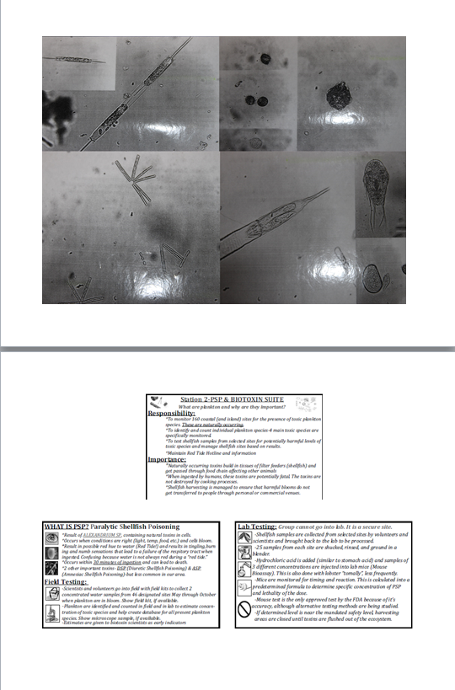
Stop #2: Public Health Wing (Biotoxins)
Paralytic shellfish poisoning – what we have the most of in Maine
Diaretic Shellfish poisoning
Amnesia Shellfish poisoning
Usually prevalent in summer (May-> Nov)
No cure, have to go to hospital and have system flushed, could result in death
First sign of paralytic is tingling of lips, followed shortly by the respiratory system shutting down
Monitor 164 sites with 200+ volunteers
How long the plankton remain in the system depends on the animal, mussels about 48hrs
Card to Handout

Slide 4
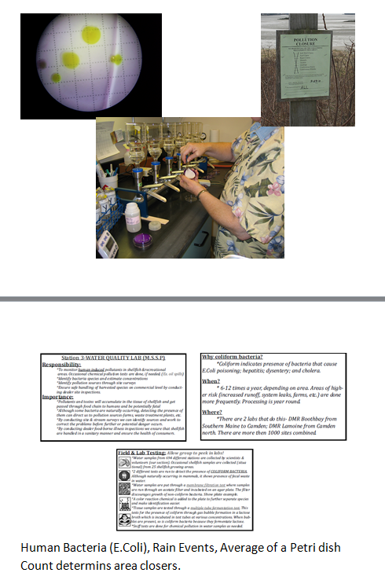
Stop #2: Public Health Wing (Water Quality)
Testing for bacteria found in human and animal guts
High rain events wash farm feces into rivers which then travel downstream
E. coli
Also walk along the river ways checking to see if any broken pipes
Test at dealers to make sure that they are not contaminating the food
Shut down areas with large quantities of bacteria or plankton, usually clam flats. Have to continue testing till get a clean sample before can be reopened
Test with mice, though a new machine has been purchased which speeds the process up. Will continue testing with mice for this year to make sure the results are the same. Mice are bread specifically for this.
Card to Handout

Slide 5
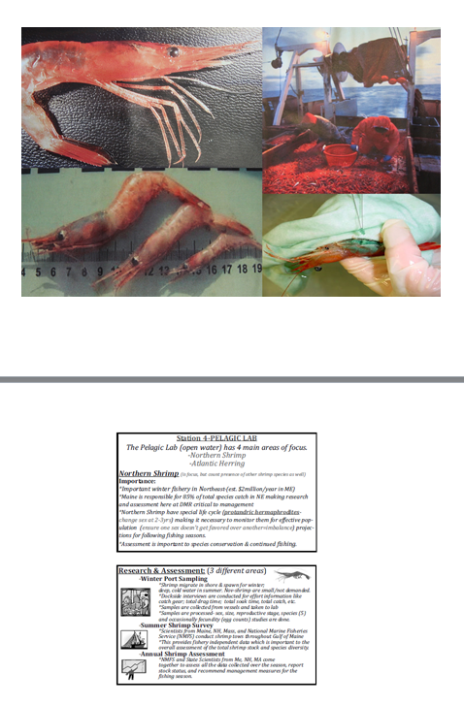
Stop #3: Pelagic Lab (Northern Shrimp)
Looking at populations for management
Protrandric hermaphrodites – start as male then switch to female when reach a certain size
Fishermen want females (3-5yrs old, die at 5)
Have to stage samples to figure out male to female ratio
Fecundity study – count the number eggs that a female has per sample. Have to look at the stage of eggs, if too far developed will hatch before Feb 15. This is bad because sun isn’t high enough to provide enough food and will die. If after 15th have a good chance of survival.
Card to Handout

Slide 6
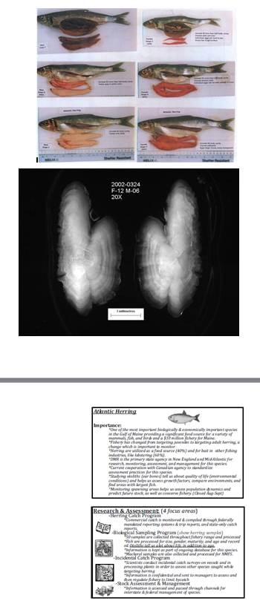
Stop #3: Pelagic Lab (Herring)
Looking at populations for management
No so much for food as much as bait
Migratory fish so have to work together with several states (Massachusetts, New Hampshire), federal, and international (Canada, Russia, China)
Survey through trawls and samples from fishermen
Testing for spawning though dissection and how old through counting the odoliths
Card to Handout

Slide 7
Stop #4: Demersal Lab
Trawl Surveys
Conducted to try and get accurate count of organisms to be able to make better management predictions
Rockweed
Seaweed that is being commercially harvested so studying to see what the impacts of it being taken is.
Sea Cucumbers
Catch process and send to Asian countries
Milbridge and Lebec, ME
Use entire cucumber – guts for fertilizer, skin dried and used to make medicine (Chondroitin’s – used for arthritis and other joint pains), muscles what’s eaten – freeze dried and used for stir-fries
Asian cultures believe eating different things cure aliments and disorders, cucumbers cover 60 of them (male issues, joint issues, fertility)
Harvested by hand and drag
Aquaculture works out of this lab, DMR not actively growing just monitoring and regulating
Recreational also work out of this lab, what catch and how caught, to try and figure out numbers taken and effect on the commercial business

Slide 8
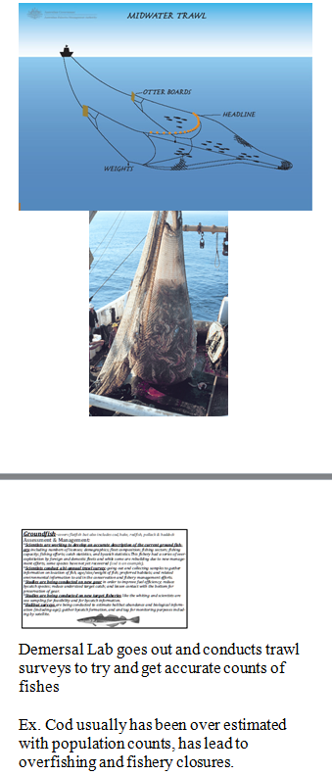
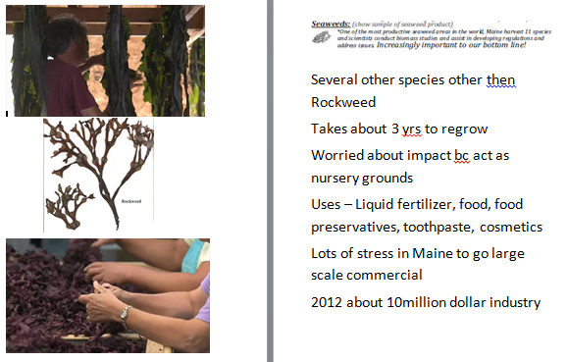
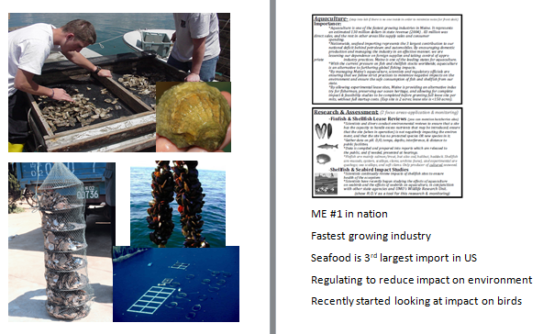
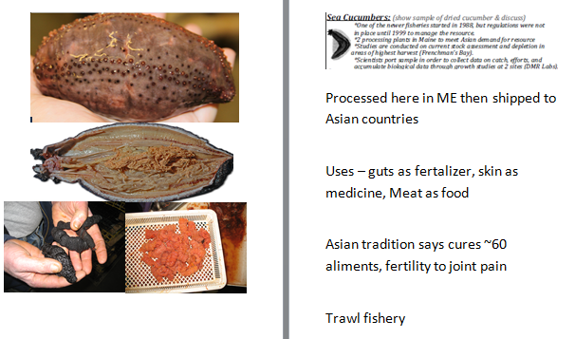
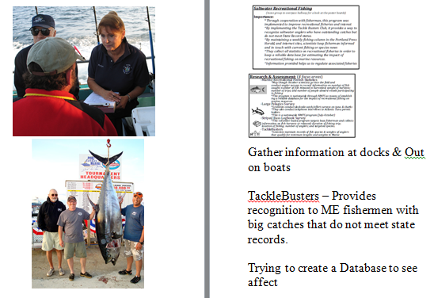
Stop #4: Demersal Lab
Cards to Handout

Slide 9
Stop #5: Posters (skip if running short of time)
Salmon, Sturgeon, and Smelt poster
Salmon
Salmon hatcheries to keep wild gene
One of the last wild populations
Screening genetics to make sure compatible, release back into the streams
Water quality issues, streams being dammed
Sturgeon
Coming back slowly
Record numbers in Portland
Caviar
Aquacultured in Maryland
Smelt
Habitat destruction – destroying streams, damming streams
Water quality
Andronomus species

Slide 10
Stop #6: Bridge (skip if running out of time)
Point out the pump house and explain how it was a federal lobster hatcher till about 1930s, was where the lobsters where brought in and striped of eggs
Library was the actual hatchery
Known since 1800s lobsters were overfished
No follow up experiments to know if lobster hatcheries are having an effect

Slide 11
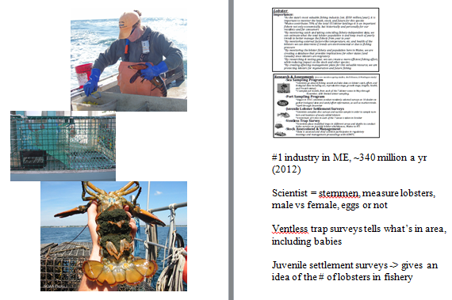
Stop #7: Lobster Lab
Migrate over state lines and internationally
Range from Canada to North Carolina
20 degrees C, about 52 degree F
Monitor number of lobsters, where caught, where selling, and for how much
Go out on the boat, measure and help. Wear a recorder to document size, females, eggs, then come in and have to enter all of that in comp
Upper and lower size limit, Maine is strictest of all states
Lobster population seems to be moving north east as water warms
Lobstermen installed V-notching to protect females
Lobster survival rate about 1%
Vent less trap studies to determine what is in area
Also have to monitor effect of lobster fisheries to other
species
About 600 lobstermen, about 600 traps per = lots of gear
in water
Whale issue (right whales, 400 remaining)
7% entanglement recovery rate. Federal regulation to switch
to sink line and break line connection
Card to Handout

Slide 12
Stop #8: Wet Lab
Where we store animals
DO NOT put hand in any ROUND tank
Can touch anything in RECTANGULAR tanks
Spend about 5 minutes. Can be done as a quick walkthrough with no touching if you have reached the 55 minutes mark of the tour.

